Slide 1

Bankruptcy Prevention

Slide 2
Batch No:5
Anushka Wable
Nagaraju
Jasthwanth
Nikhitha
Ram sharan

Slide 3
Content
What is meant by Bankruptcy
Methodology and Dataset Details
Data Preprocessing and EDA
Model Building
Model Evaluation
Model Deployment
Conclusion

Slide 4
What Is meant by bankruptcy
Bankruptcy is a legal process that occurs when an individual, business, or organization is unable to repay its debts to creditors. It is a formal declaration of financial insolvency and is governed by the laws of the respective jurisdiction. Bankruptcy aims to provide relief to the debtor by either restructuring or discharging debts and, simultaneously, ensures fair treatment for creditors.
Bankruptcy Prevention:
Bankruptcy prevention is the proactive process of identifying, addressing, and mitigating financial risks before they escalate into insolvency. This involves a combination of strategic planning, financial analysis, cost control, and decision-making to ensure financial stability and sustainability.
The importance of bankruptcy prevention cannot be overstated, as it not only protects the financial health of individuals and organizations but also contributes to economic stability at a broader level.

Slide 5
METHODOLOGY
Python language:
It is a rich language for data science and AI.
Libraries:
Pandas, Numpy, matplotlib, seaborn etc.
Algorithms used:
We have used LOGISTIC REGRESSION, KNN, SVM, Multinomial Naive Bayes, Gaussian Naive Bayes.
Streamlit UIs
Provided user interface using streamlit.

Slide 6
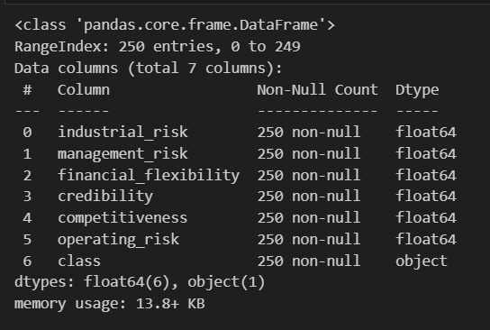
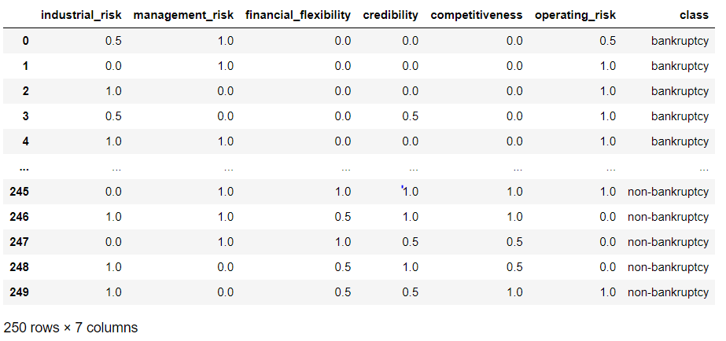
Dataset Details

Slide 7
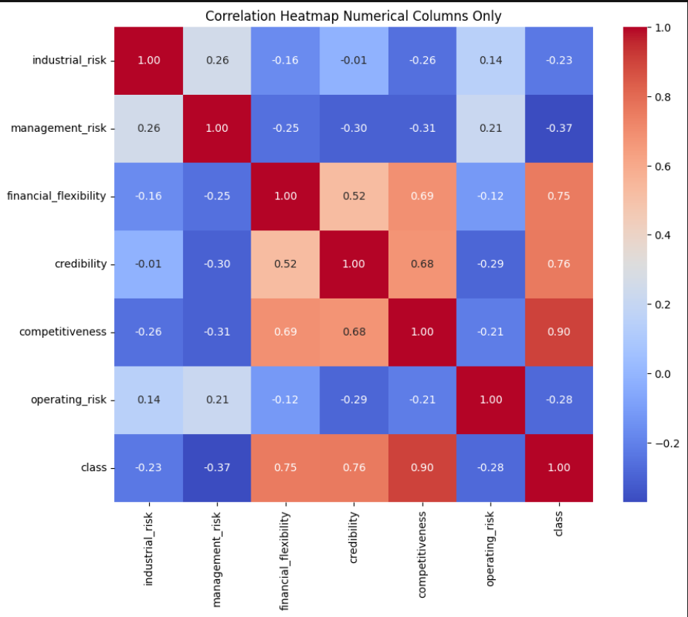
Correlation matrix
Industrial risk and management risk is mostly correlated with each other.
Financial flexibility is highly correlated with competitiveness and credibility
Similarly, competitiveness is correlated with financial flexibility and credibility

Slide 8
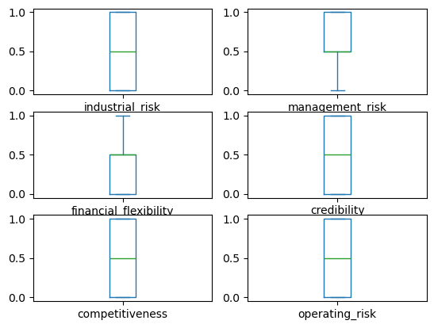
DATA PREPROCESSING AND EDA
industrial_risk Axes(0.125,0.653529;0.352273x0.226471) management_risk Axes(0.547727,0.653529;0.352273x0.226471) financial_flexibility Axes(0.125,0.381765;0.352273x0.226471) credibility Axes(0.547727,0.381765;0.352273x0.226471) competitiveness Axes(0.125,0.11;0.352273x0.226471) operating_risk Axes(0.547727,0.11;0.352273x0.226471) dtype: object

Slide 9
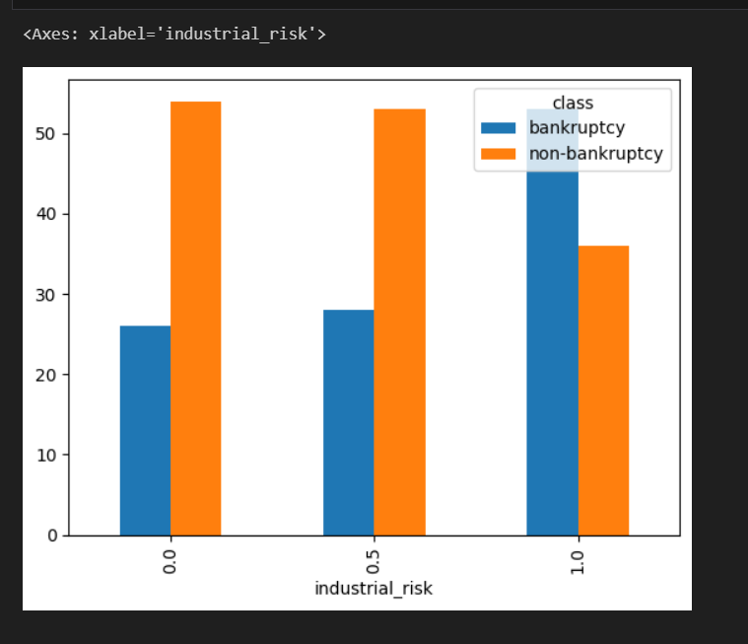
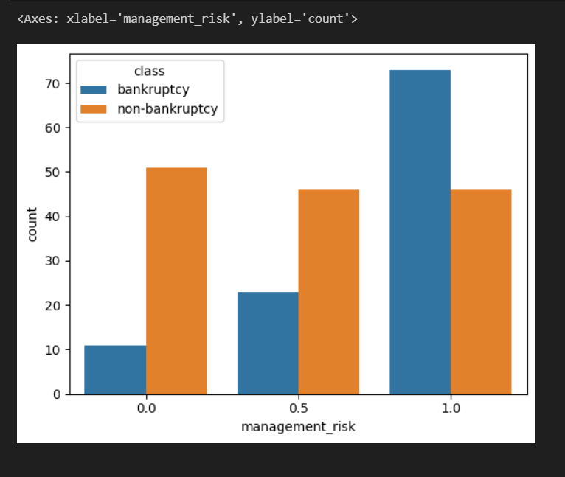

Slide 10
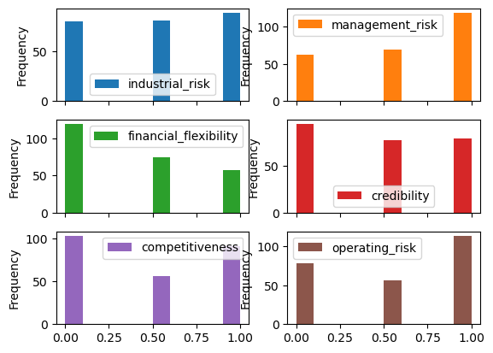
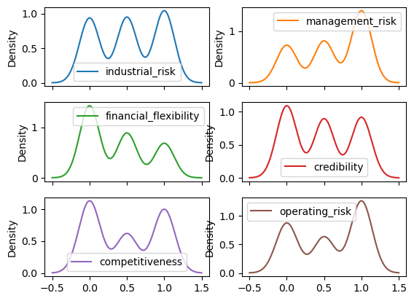

Slide 11
MODEL BUILDING
1. Logistic regression:
Logistic regression is a widely used statistical method for modeling binary outcomes (e.g., success/failure, yes/no, 0/1).
It is particularly effective when the dependent variable is categorical, such as predicting the likelihood of bankruptcy (bankrupt vs. non-bankrupt).
2. KNN(K-Nearest Neighbors):
K-Nearest Neighbors (KNN) can be effectively applied to predict bankruptcy by analyzing financial and operational data.
It identifies patterns in a company's metrics and compares them with similar companies (neighbors) to assess bankruptcy risk.

Slide 12
3. SVM(Support Vector Machines ):
Support Vector Machines (SVM) is a powerful machine learning algorithm widely used for classification and regression tasks.
It is especially suitable for binary classification problems, such as predicting bankruptcy (bankrupt vs. non-bankrupt).
4. Gaussian Naive Bayes :
Gaussian Naive Bayes (GNB) is a probabilistic classification algorithm based on Bayes' Theorem. It assumes that the features are independent (naive assumption) and follow a Gaussian (normal) distribution.
This makes GNB particularly efficient and effective for classification tasks, including bankruptcy prediction.
5. Multinomial Naive Bayes (MNB) :
Multinomial Naive Bayes (MNB) is a probabilistic machine learning algorithm often used for classification tasks. It is particularly effective when the features represent counts or frequencies.
In the context of bankruptcy prevention, MNB can be adapted to classify companies or individuals into various bankruptcy risk categories based on discrete financial or operational data.

Slide 13
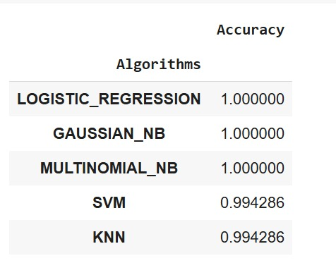
Model evaluation
Model evaluation is a critical step in assessing the performance of different algorithms in bankruptcy prevention. For algorithms like Logistic Regression, Support Vector Machines (SVM), K-Nearest Neighbors (KNN), Multinomial Naive Bayes Gaussian Naive Bayes (GNB).
various evaluation metrics can determine their effectiveness in predicting bankruptcy.

Slide 14
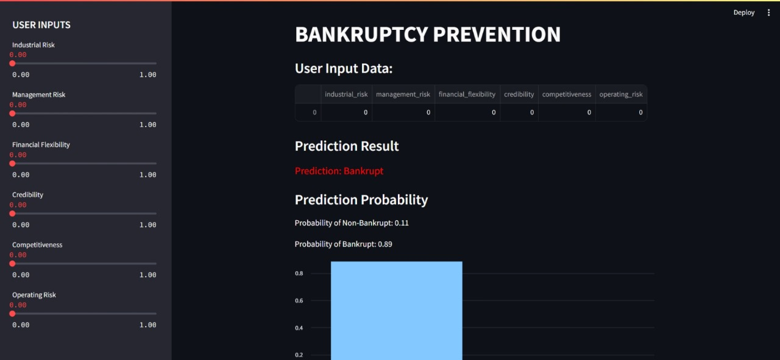
Model Deployment on Streamlit
Model deployment involves making the trained bankruptcy prediction model available for use in real-world applications, such as predicting the bankruptcy risk of companies based on financial data. This step is crucial for integrating the model into decision-making processes.

Slide 15
Conclusion
Effective tools for bankruptcy detection and prevention
Leverage machine learning for decision making
Continuous improvement for real-world applications.

Slide 16


